Slide 1
MENTAL HEALTH TRACKER
Group Number: 5
Group Name: Cool Health Guides
Group Members:
EL BESTAWY, Mahmoud
HOSSAIN, Farin
RAHMAN, Naslin
CHEN Yuxin (Katy)
LI, Zhuoqian (Allison)

Slide 2

MEET OLIVER

Slide 3
“
Our solution aims to provide students with a platform that helps them track their mental health and seek help as necessary.
”

Slide 4
USER RESEARCH
Surveys
Interviews
Focus Groups
12 responses
10 participants
1 session with 3 participants
Notes:
We conducted user research with 12 survey responses, 10 interview participants, and a virtual focus group session with 3 students.

Slide 5
USER RESEARCH TAKEAWAYS
Academic challenges and the lack of social interaction were major factors that contributed to worsening mental health among students
Mental health support:
Many do not reach out for support.
Online services
Lower appointment attendance rate
Issues booking appointments online
Notes:
Some key takeaways were that academic challenges and the lack of social interaction were major factors that contributed to worsening mental health among students.
As for mental health support, most students did not reach out for support because they thought it was not applicable despite having reported worsening mental health. Instead many participants relied on friends and family, and one participant recommended journalling which helped identify patterns bad for their health.
For the students that have reached out for support from the services offered by the university, they’ve reported lowered appointment attendance rate and experienced issues booking appointments online as a result of the pandemic causing these services to shift online.

Slide 6
Proposed solution
Journals and Self-Assessment
Promote self-reflection
Improve self-care
Message and Workshop
Convenient process
Support find you
Reports
Better support quality
Eliminate the sense of distance

Slide 7

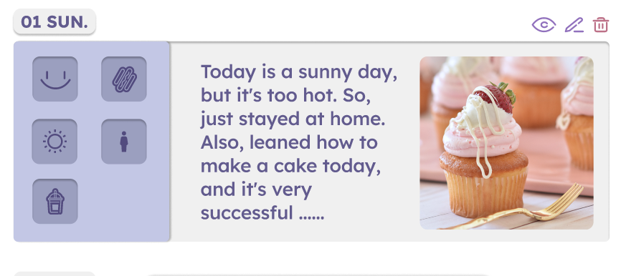
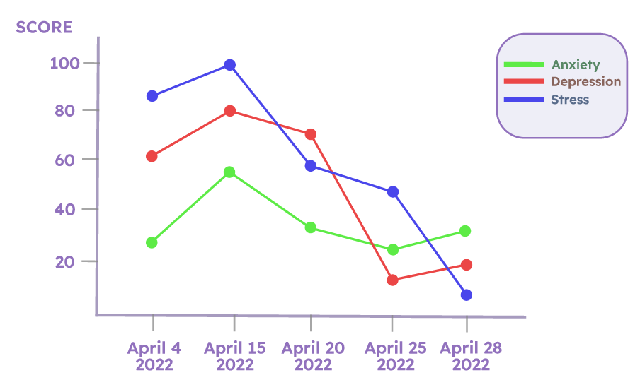
Proposed Solution: Advantages
Customizable Journals
Comparable Trends
Designed Specifically for UofT students And H&W Center
Notes:
The advantages of our product over other ones are a combination of our customizable Journals and comparable Trends for different issues users may experience such as Stress and Anxiety.
What makes our product unique is that is specifically designed for UofT students and
UofT's H&W center. Giving users the option to anonymously send their results to the H&W, who in turn will reach out to students for 1 on 1 counseling sessions though our site will hopefully create a stronger relationship between the two as opposed to the standard booking system. H&W will also be using the data and trends from the assessments to host various Workshops for students who want more support, which they can sign up for through our site.

Slide 8
DEVELOPMENT PROCESS
Notes:
To develop our prototype, we each initially devised a low fidelity prototype for 2 tasks. Using the feedback from pilot testing sessions, we discussed within the group to decide on a design for each task, taking into consideration the pros and cons of each team member's designs.

Slide 9
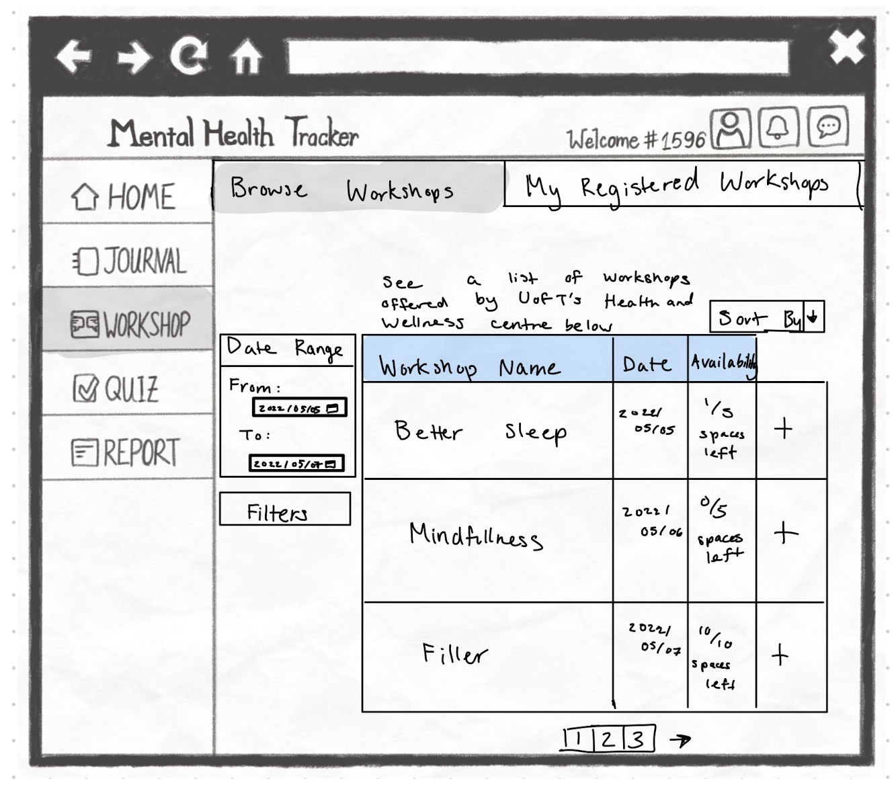
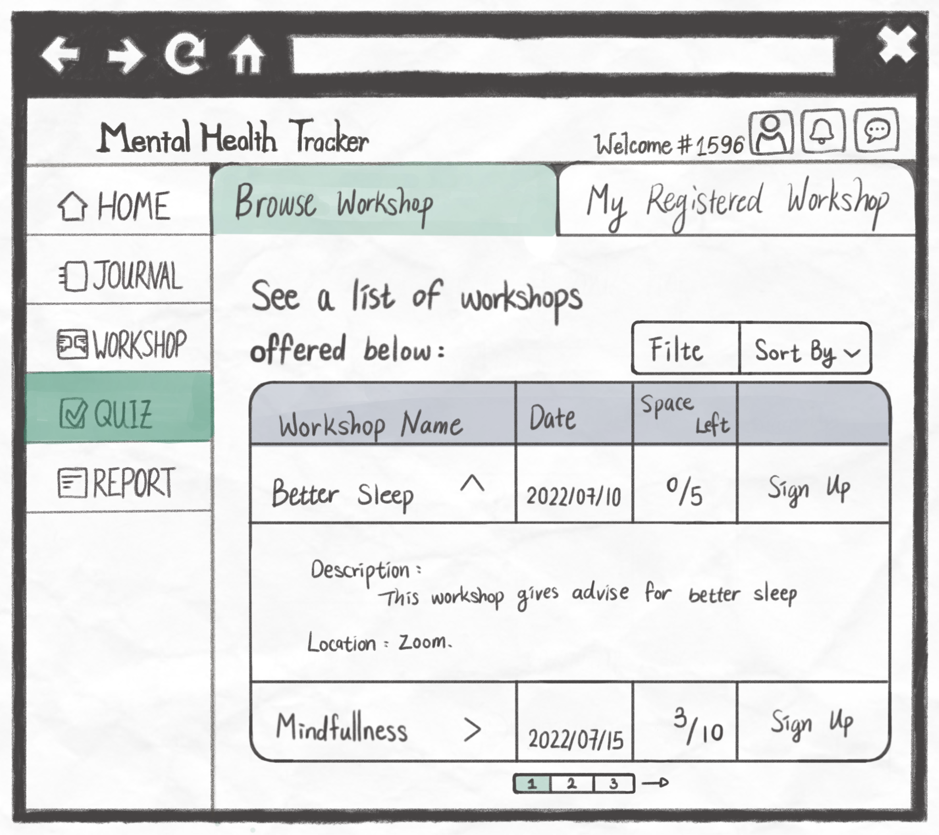
INTERNAL EVALUATION
Neilson’s Heuristic Violations
Match between system and the real world
User control and freedom
Flexibility and efficiency of use
Aesthetic and minimalist design
Notes:
For our internal evaluation of our combined low-fi prototype, we did a cognitive walkthrough and Nielsen's heuristics evaluation. Some of the major issues we discovered during this process was that the workshop page was cluttered and some buttons were ambiguous, so we improved this design by altering the layout.

Slide 10
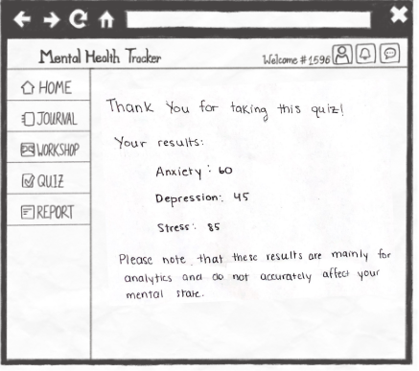
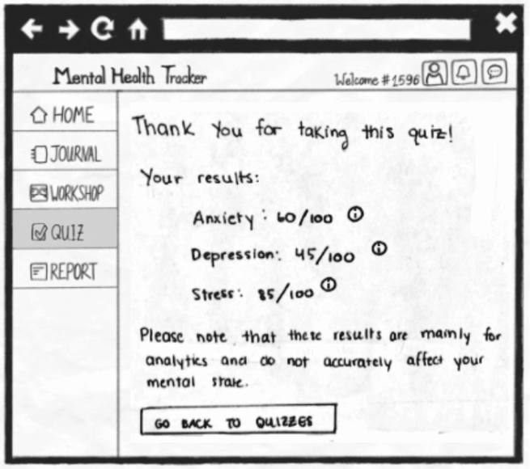
INTERNAL EVALUATION
Neilson’s Heuristic Violations
Visibility of system status
Match between system and the real world
Help and documentation
Notes:
We also realized that the assessment results page did not provide enough information for the user to fully understand their results, so we added more context for the scores and categories

Slide 11
USABILITY TESTING FEEDBACK
Users liked the purpose and mission
Found most tasks easy to complete
Most would recommend website to others
Were confused on how to complete a self assessment
Legend of report was ambiguous
Dashboard was confusing
Journal icon selection could be clearer
Notes:
Using our findings, we created our high fidelity prototype on Figma.
Here’s the summary of our feedback from our usability testing session:

Slide 12
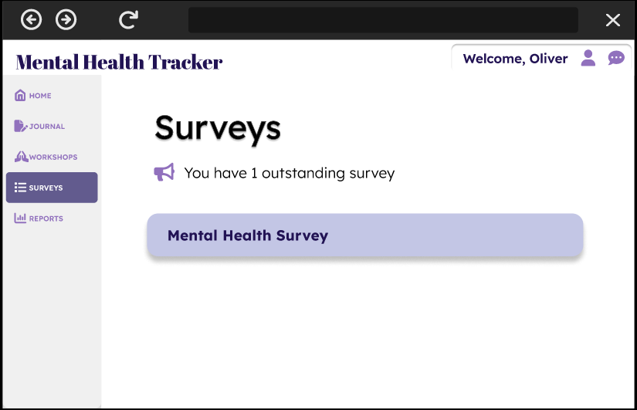
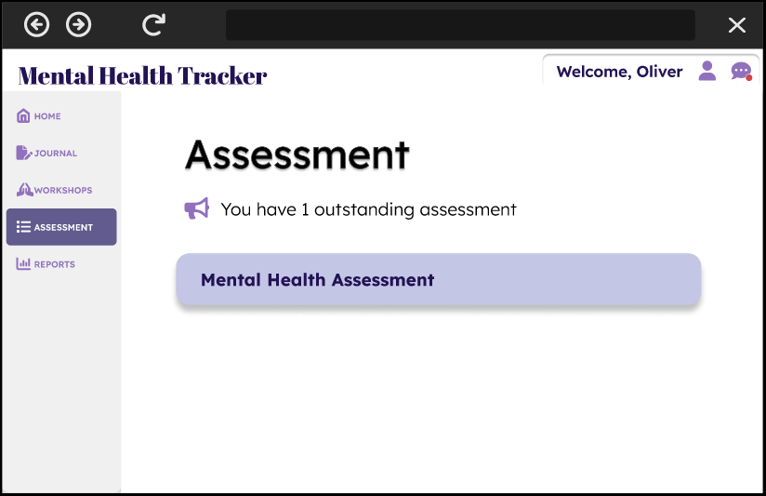
HI - FI
Notes:
We noticed that some people were having trouble completing a self assessment since they did not know where to navigate to, so we changed the name Surveys to Assessments to eliminate this confusion.

Slide 13
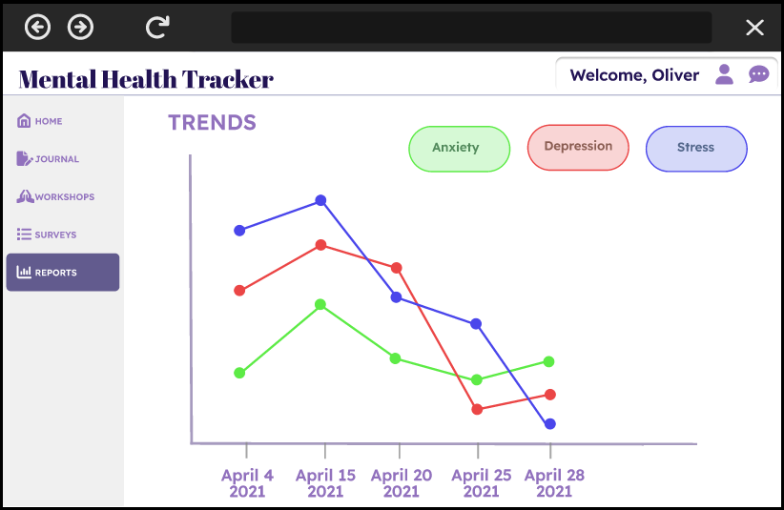
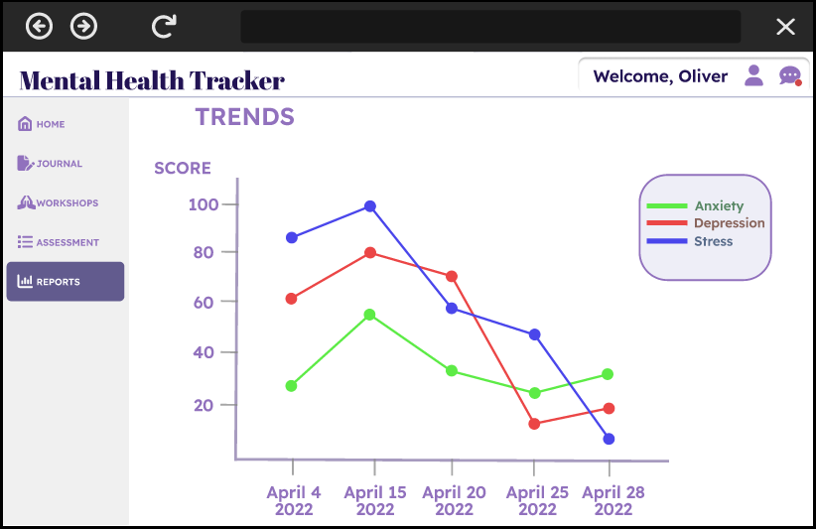
HI - FI
Notes:
Some individuals also mentioned they struggled to interpret the report because the legend and y-axis labels were unclear, so we added labels and improved the legend design.

Slide 14
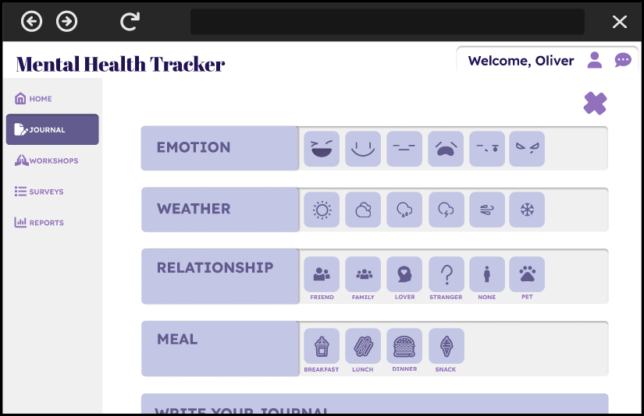
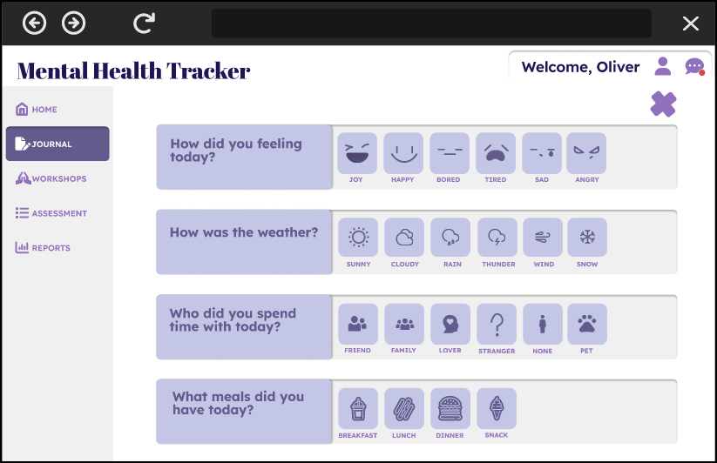
HI - FI
Notes:
Additionally, some users weren’t sure how to interpret these prompts for the journaling section, so we discussed how to make the prompts more intuitive.

Slide 15
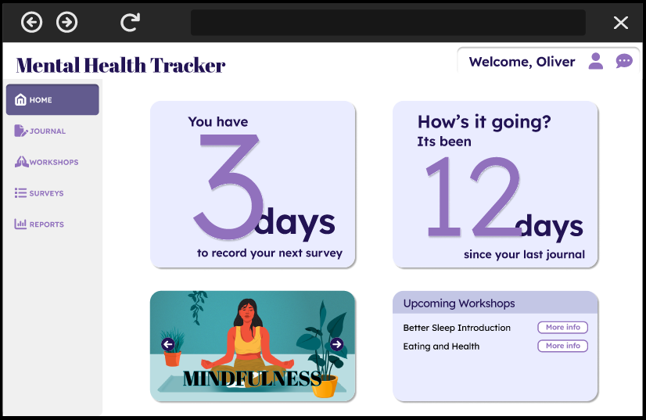
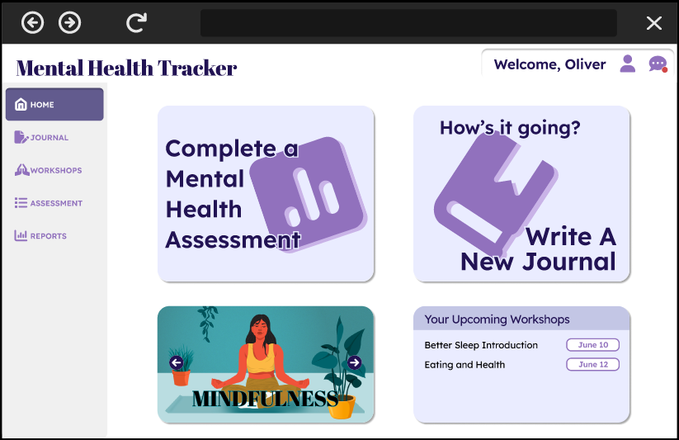
HI - FI
Notes:
Some participants found the dashboard cards a little confusing, and found that it was grabbing their attention away from the navigational panel. We fixed this issue by clarifying the text on the cards.

Slide 16
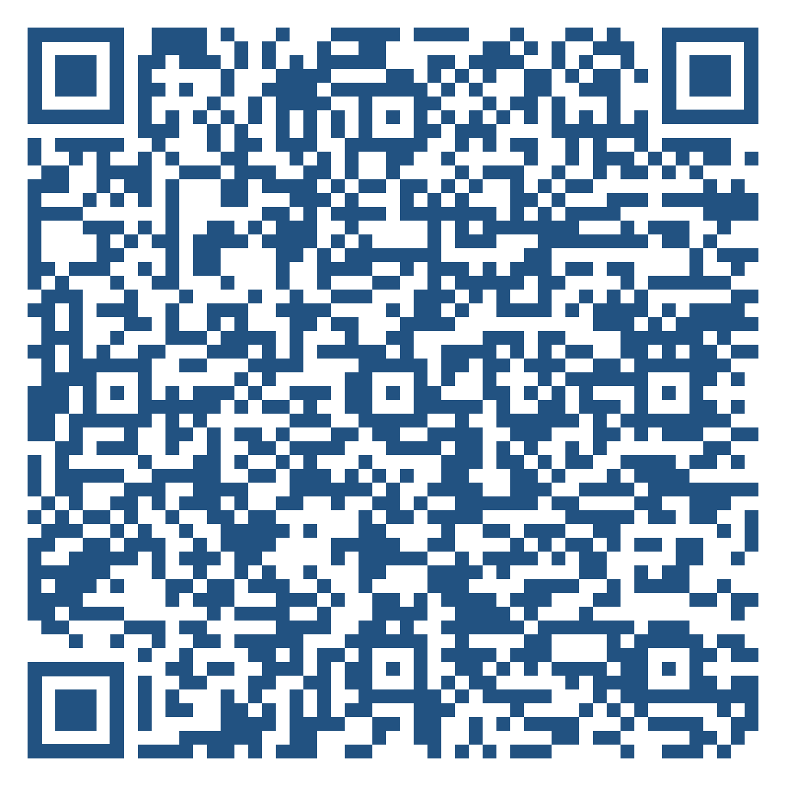
TRY IT OUT!
https://bit.ly/3Q6ecVz

